Slide 1
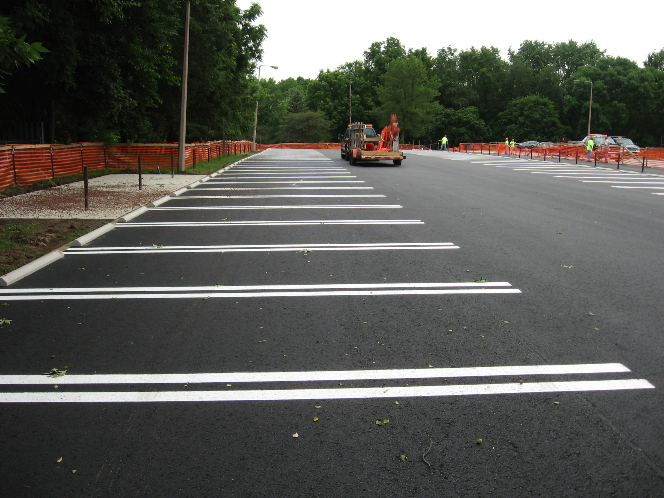
Data Structure and AlgorithmS Review 3 Topic:- Car Parking System in India
By:-
Om Ashish Mishra -16BCE0789
Mayank Nandwani -15BCM0012

Slide 2
Introduction
The car parking system in India is very disappointing, therefore we have need to make an efficient car parking system using Binary Search Tree, Linked List and Queue as our features of the data structures.
Binary Search Tree is used to make the parking lot.
Linked list is used to make the connections.
Queue is used to fill the parking space with cars.

Slide 3
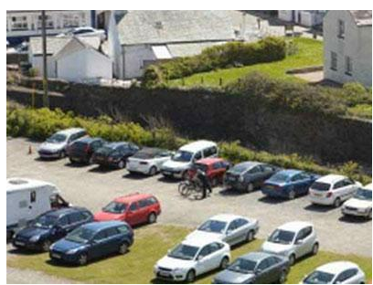
India’s car parking system is an example
KOLKATA: City's car parking system in India is in a mess. This admission on Tuesday came from none other than city mayor Sovan Chatterjee himself. Following scores of complaints from across the city, the Kolkata Municipal Corporation on Tuesday decided to scrap ties with present cooperative agencies running city's car parking lots. The civic body will invite a fresh tender after the pujas. Meanwhile, the agencies now entrusted to run parking lots will be allowed to manage those till pujas are over. This decision was taken on Tuesday in the mayor-in-council meeting.

Slide 4
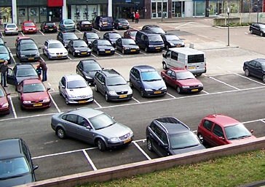
USA’s car parking system is an example
Modern technology in US offers the ability to revolutionize current parking management. In this way operators can also improve their customer service.
The real time information that becomes available can be used to manage operations more efficiently and adjust strategy to real time demand.
Car park operators can monitor and analyse the parking behaviour of frequent users, knowing exactly when they are parking in the facilities. Parking spaces can be allocated according to real time demand directly resulting in improved car park utilisation and revenue enhancement.

Slide 5
How Parking Guidance System works:
Ultrasonic sensor is based on radar principle where time is measured by emission of sonic signal & return of its echo to determine the presence of vehicle.
Detect, Count & Indicate the vacant places online.
Vacancy Indicator & Display Panels are based on L.E.D. technology to minimize power consumption & increase visibility with long maintenance-free life.
Master Controller interface between Application Software & other Parking devices & Zone Controller manages the information on a car park zone or level & communicates with other Zone Controllers & Master Controller.
Parking Guidance System Software is based on SQL database and user friendly operation with highest level of security.

Slide 6
Benefits of Parking Guidance System:
It is estimated that 30% of traffic congestion during parking is attributed to vehicle looking for parking space.
A parking system can lead to a non trivial reduction in vehicle emission. Typical benefits are 2% reduction in emission of CO.
Cost optimization by progressive openings of levels as necessary. Closed levels can save electricity by switching off lighting, ventilation etc.
Validation of the premium charged for parking by providing efficient and user friendly parking facility.

Slide 7
Our Program

Slide 8
The Header Files
#include <stdio.h>
#include <stdlib.h>
#include<string.h>
#include<conio.h>
#include<windows.h>

Slide 9
The Binary Search Tree for Parking lot
struct Parking
{
char value[100]; //Value of the car number
struct Parking* l; //Left pointer of the tree
struct Parking* r; //Right pointer of the tree
}*root = NULL,*temp = NULL,*t2,*t1;

Slide 10
Pointers of the tree
Root is the starting point of the tree and temp is a temporary pointer the tree to continue.
Pointers t1 and t2 are used for
t1 is used to delete or find leaf node with 0 children or 1 child(left or right)
t2 is used to delete 2 children in the tree and for finding smallest and largest element in tree

Slide 11
Functions of the tree
void insert(): To insert a node into the tree
void create(): To create a node
void search(struct Parking*t): To search for another node position if the root node is present
void display(struct Parking*t): For traversal of the nodes
void delete(): To delete a node form the tree
void search1(struct Parking*t,int data): To search for the position of the desired root to be deleted
void delete1(struct Parking*t): To delete the node it can be of 0,1 or 2 children
int smallest(struct Parking*t): To calculate the smallest node on the left
int largest(struct Parking*t): To calculate the largest node on the right
void count_Cars(): To count the number of cars present in the Parking Lot

Slide 12
Queue for waiting cars outside the Parking Lot
struct node
{
char info[100];
struct node *ptr;
}*front,*rear,*TEMP,*front1;
The front pointer represents the car at the starting of the queue.
The rear pointer represents the car at the end of the queue.
TEMP is the pointer used to make.
The front1 is used for dequeuing cars.

Slide 13
The functions of queue
void frontelement(): The car present at the first position in the queue
void enq(char data[100]): The insertion of the cars in the queue
void deq(): The deletion of the cars in the queue
void empty(): Checking for the queue is empty or not
void searching1(char data): To insert car into the tree from the queue
void create11(): To start the queue Linked list
void queuesize(): To see the number of cars present in the queue

Slide 14
Global Variables:
int flag=1,i;
int c=0,k = 97,k1=1,k11=1,h=0;
int qs=0;
int j=0;
int count = 0;
char s[100],s1[100];
char e[100],f[10];

Slide 15
The important functions
void main(): It is used to handle password related programming and calling the start()
void start(): It is used to handle the mechanism of binary search tree
void queue_System(): It is used to handle the mechanism of the queue

Slide 16
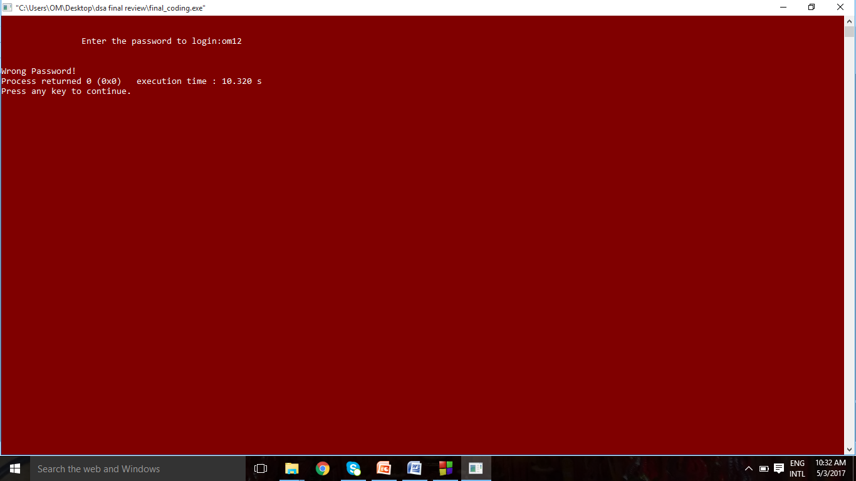
The output Wrong password!!

Slide 17
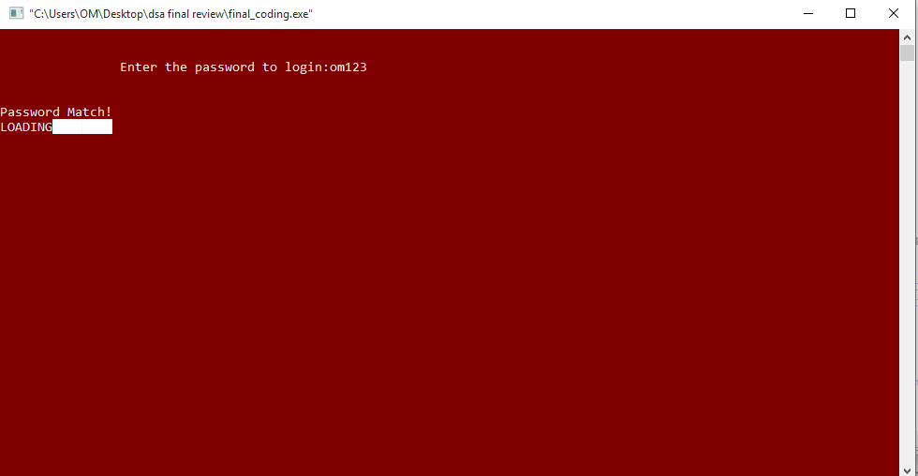
Correct password

Slide 18
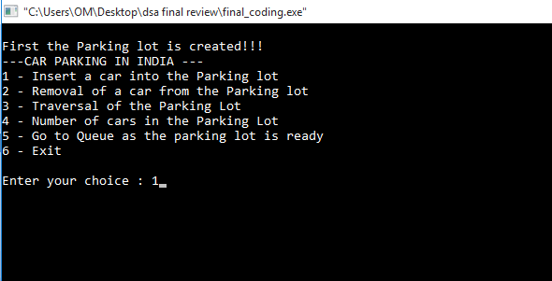
Insertion into Binary search tree

Slide 19

The car inserted

Slide 20
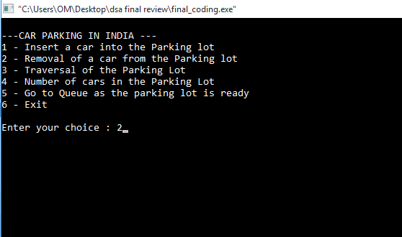
Again car insertion removal of elements(deletion):

Slide 21

Car to be delected

Slide 22

Traversal

Slide 23
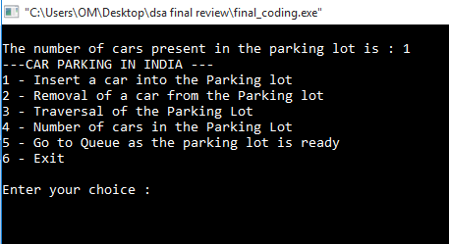
The number of cars in the parking lot

Slide 24

Creating space for in the parking lot insertion of space

Slide 25

Traversal

Slide 26

Now going for queue

Slide 27
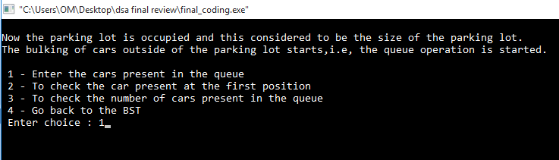
Insertion by queue

Slide 28
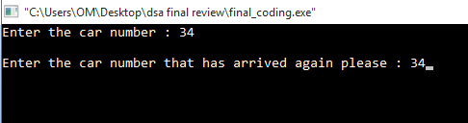
Insertion in queue and binary search tree

Slide 29
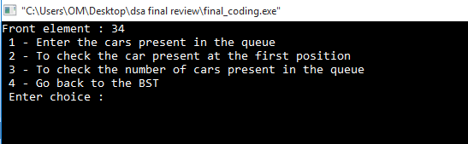
To check the car in front position

Slide 30
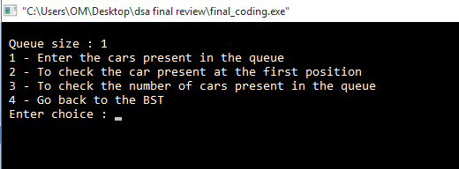
Checking the size of queue

Slide 31

Going back to tree

Slide 32

Queue is freed

Slide 33

traverl

Slide 34

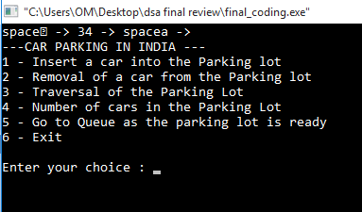
deletion

Slide 35
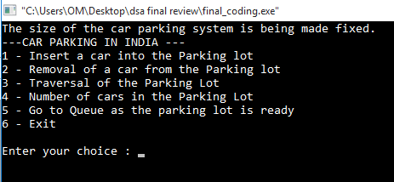
Insertion

Slide 36
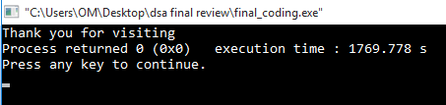
Exit form program

Slide 37
Conclusion
Our program helps in finding a suitable to an empty parking space, hence it reduces people’s time and energy in finding a good parking space.
This helps in managing parking lots, in a better way.

Slide 38
Thank You!

